Slide 1
PRECISION FARMING INTELLIGENCE
Executive Precision Farming Dashboard
District-level yield, land use, nutrient efficiency and climate response
8 analytical views • 1 executive dashboard • 10 findings

Slide 2
PRECISION FARMING ANALYTICS
About the dataset
The dashboard combines eight views around one dataset: district-year crop records covering area, yield, rainfall, temperature, soil pH and NPK application. A metric-selector parameter lets a viewer pivot the headline KPI between yield, production, rainfall, temperature, area and NPK usage.
The Eight Views
Production & Yield Trend (dual-axis, by year)
District Pareto Analysis (80/20 concentration)
Regional Input Efficiency (state-level, LOD)
Land Usage Treemap (area by crop & state)
Climate Sensitivity Heatmap (rainfall x pH)
Crop Yield Distribution (box plot, by crop)
NPK Nutrient Balance (requirement index)
Dynamic Metric Switcher KPI
🌾
18.4M t
📈
2,340 kg/ha
Total Production
Avg. Yield
🗺️
7.9M ha
⚖️
146 kg NPK/ha
Total Area
Input Efficiency
Illustrative sample data — replace with your extract
Section 1 of 8 · Dashboard overview
Executive Precision Farming Dashboard

Slide 3
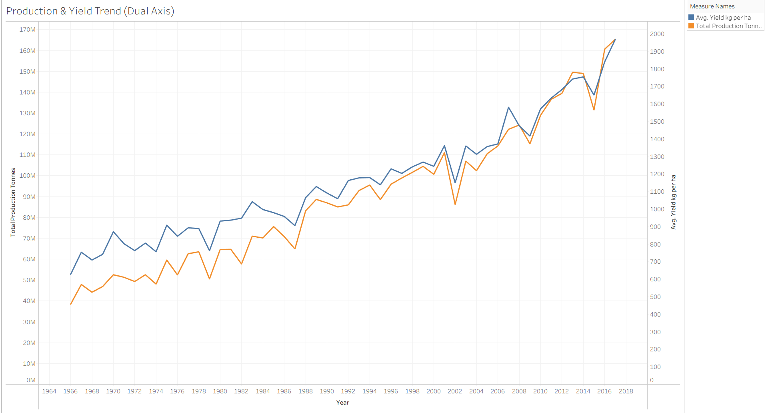
SHEET 1
Production & Yield Trend
What it shows
1. Consistent Upward Growth
Total crop production increased from about 38 million tonnes in 1966 to 165 million tonnes in 2017, showing substantial long-term growth in agricultural output.
2. Strong Correlation Between Yield and Production
The production and yield trends move closely together throughout the years, suggesting that higher productivity per hectare is a key driver of increased crop production.
3. Recovery After Periodic Declines
Although there are noticeable drops around 1979, 1987, 2002, and 2015, both production and yield recover quickly afterward, demonstrating the resilience of the agricultural sector.
Agricultural production and yield have grown steadily over the last five decades, with productivity improvements playing a major role in achieving record production levels despite occasional setbacks.
Section 2 of 8 · Production & Yield Trend
Executive Precision Farming Dashboard

Slide 4
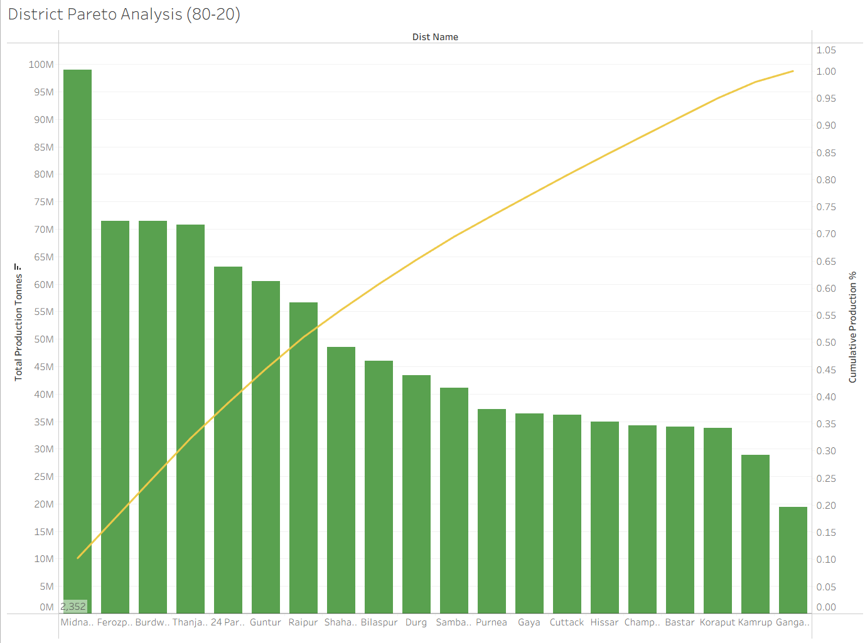
SHEET 2
District Pareto Analysis (80/20)
What it shows
1. A Few Districts Contribute a Large Share of Production
The Pareto chart shows that the top-performing districts contribute a disproportionately large share of total crop production. The cumulative line rises steeply in the beginning, indicating that a small number of districts drive a significant portion of agricultural output.
2. Midnapore is the Leading Producer
Midnapore has the highest production among all districts, with nearly 100 million tonnes.
Its production is substantially higher than most other districts, making it a key contributor to overall agricultural output.
3. Targeting Top Districts Can Have the Greatest Impact
Since a relatively small group of districts accounts for most of the production, focusing investments, technology adoption, and infrastructure improvements in these districts could significantly influence overall agricultural performance.
Section 3 of 8 · District Pareto Analysis
Executive Precision Farming Dashboard

Slide 5
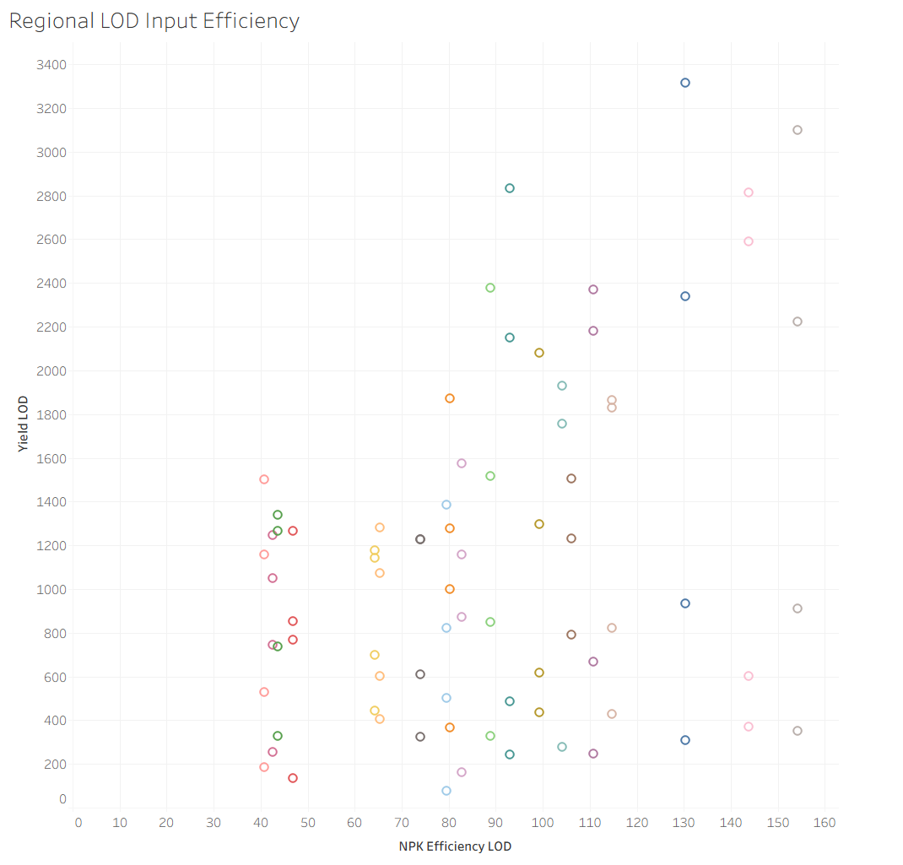
SHEET 3
Regional Input Efficiency
What it shows
1: Higher NPK Efficiency Generally Leads to Higher Yield
Most points with NPK Efficiency above 100 are associated with higher yield values, indicating a positive relationship between nutrient-use efficiency and crop productivity. This suggests that optimizing fertilizer utilization can significantly improve agricultural output.
2: Similar NPK Levels Produce Different Yields
At the same NPK efficiency range (e.g., 80–120), yields vary widely from below 500 kg/ha to above 2500 kg/ha.
This indicates that factors beyond fertilizer efficiency—such as rainfall, soil quality, temperature, and crop type—also have a strong influence on yield performance.
While improved NPK efficiency is generally associated with higher crop yields, fertilizer management alone does not determine productivity. Significant yield variation at similar efficiency levels highlights the importance of climate, soil conditions, and crop-specific factors in achieving optimal agricultural performance.
Section 4 of 8 · Regional Input Efficiency
Executive Precision Farming Dashboard

Slide 6
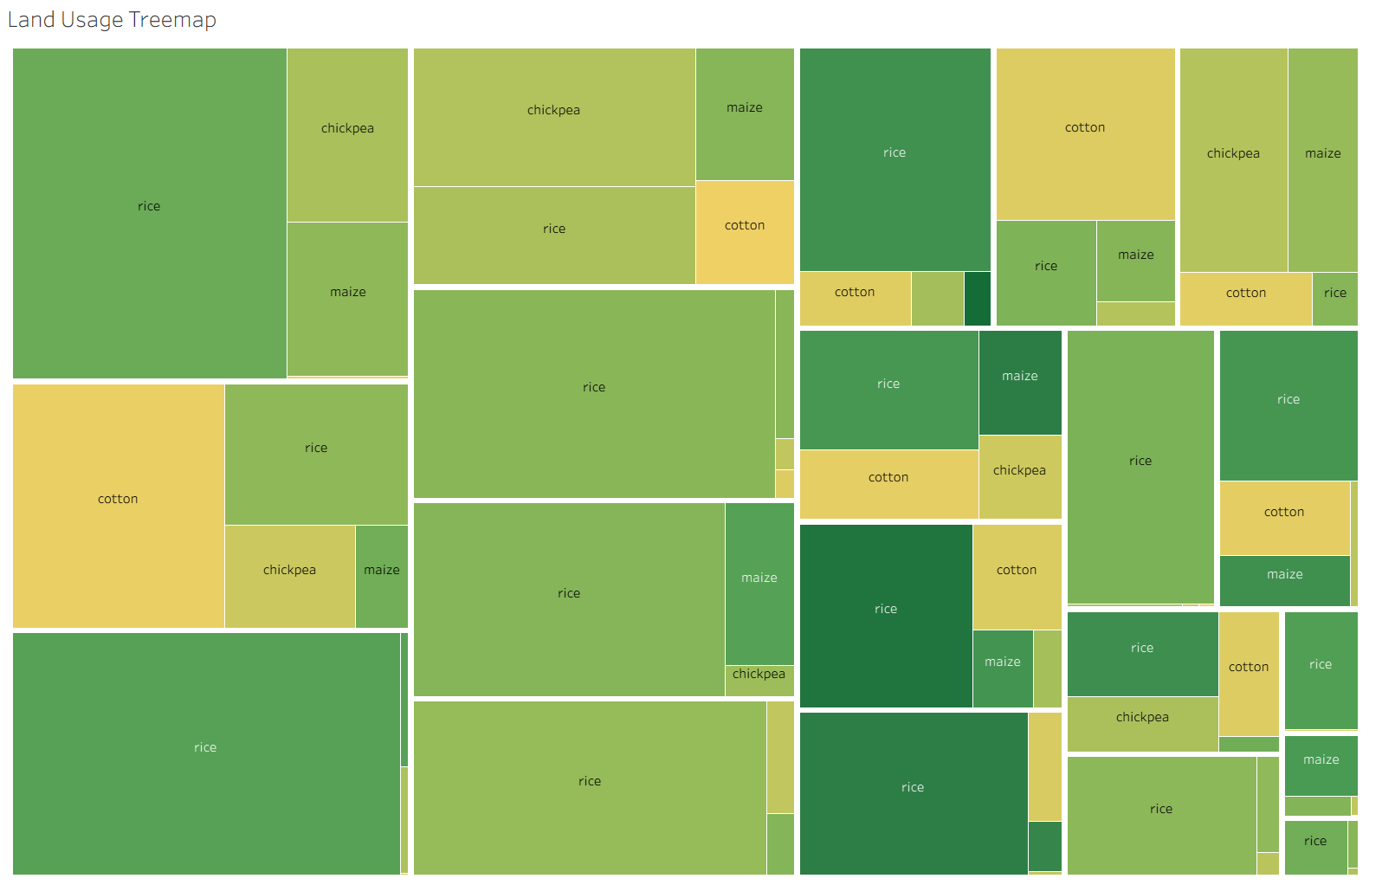
SHEET 4
Land Usage Treemap
What it shows
1: Uttar Pradesh Dominates Agricultural Land Usage
Uttar Pradesh occupies the largest share of cultivated land in the treemap, making it the most significant contributor to agricultural area among all states.
A large portion of this land is dedicated to rice cultivation, highlighting the state's importance in overall crop production
2: Rice is the Most Land-Intensive Crop Across States
Rice appears as the largest block in most states, indicating that it consumes the highest share of agricultural land compared to cotton, maize, and chickpea.
This suggests that rice remains the dominant crop driving land utilization patterns across India.
Darker = higher average yield
Section 5 of 8 · Land Usage Treemap
Executive Precision Farming Dashboard

Slide 7
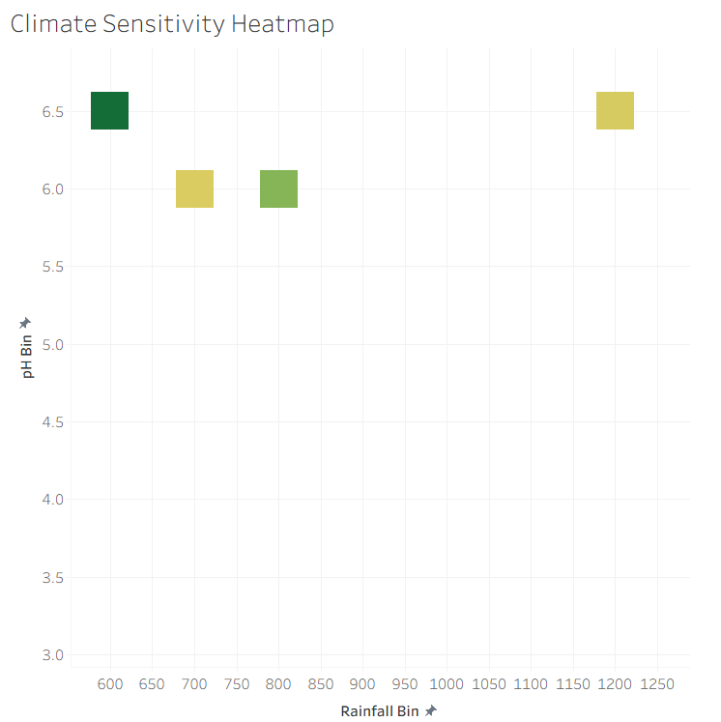
SHEET 5
Climate Sensitivity Heatmap
What it shows
1: Optimal Yield Occurs at Moderate Rainfall and Slightly Acidic Soil
The highest yield (darkest green cell) is observed around 600 mm rainfall and pH 6.5.
This suggests that slightly acidic soils combined with moderate rainfall create favorable conditions for crop growth and productivity.
2: Increasing Rainfall Does Not Always Increase Yield
Areas receiving 1200 mm rainfall show lower yields (lighter color) compared to the 600–800 mm range.
This indicates that excessive rainfall may not necessarily improve crop performance and can sometimes reduce productivity.
Crop yield is influenced by the interaction of rainfall and soil pH rather than rainfall alone. The highest productivity is achieved under moderate rainfall levels and near-optimal soil pH (around 6.5), highlighting the importance of balanced environmental conditions for maximizing agricultural output.
R
Section 6 of 8 · Climate Sensitivity Heatmap
Executive Precision Farming Dashboard

Slide 8
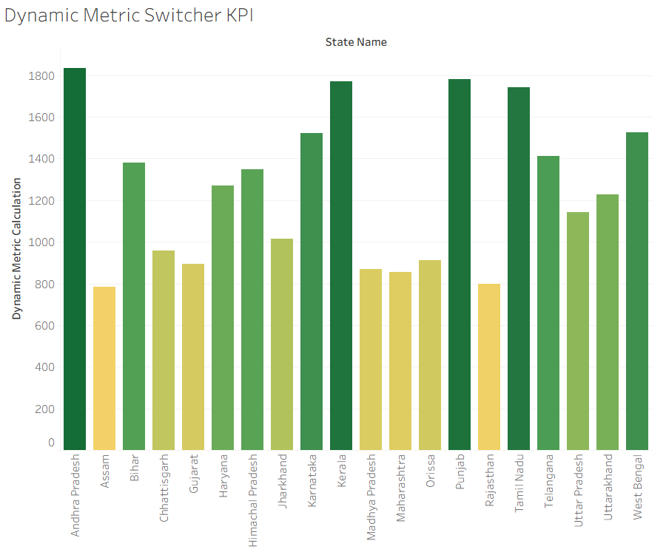
SHEET 6
Crop Yield Distribution
What it shows
Distribution of yield per crop across all district-years — not just the average, but how consistent that average is.
A tall spread means yield swings a lot district-to-district or year-to-year for that crop; a tight spread means it's dependable.
Illustrative insight: the highest-average crop is also one of the most variable — a reminder that the Pareto and trend views can hide risk that only shows up here.
Recommendation: pair high-average, high-variance crops with a risk mitigation plan (irrigation, crop insurance) rather than treating the average as guaranteed.
Note: full distribution (quartiles, outliers) is best judged in Tableau directly — this view summarizes the average as a stand-in.
Section 7 of 8 · Crop Yield Distribution
Executive Precision Farming Dashboard

Slide 9
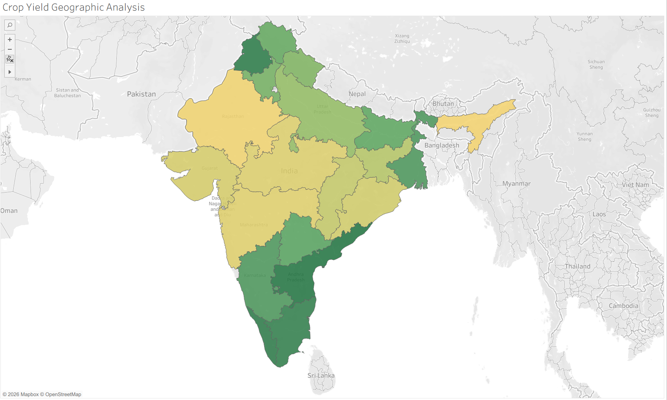
SHEET 7
Crop yield geographic analysis
What it shows
1. Southern States Show Higher Crop Yields
States such as Tamil Nadu, Andhra Pradesh, Karnataka, and Kerala are shaded darker green, indicating comparatively higher crop yields.
This suggests better agricultural productivity, likely supported by irrigation infrastructure, favorable climate, and intensive farming practices.
2. Central and Western India Have Moderate to Lower Yields
States like Madhya Pradesh, Maharashtra, Rajasthan, and Gujarat appear in lighter shades.
These regions may have lower average yields compared to the southern states, highlighting opportunities for productivity improvement
Crop yield is unevenly distributed across India, with southern states emerging as the most productive regions. The geographic pattern highlights the influence of regional agricultural practices, climate, and resource availability on crop performance.
Section 8 of 8
Executive Precision Farming Dashboard

Slide 10
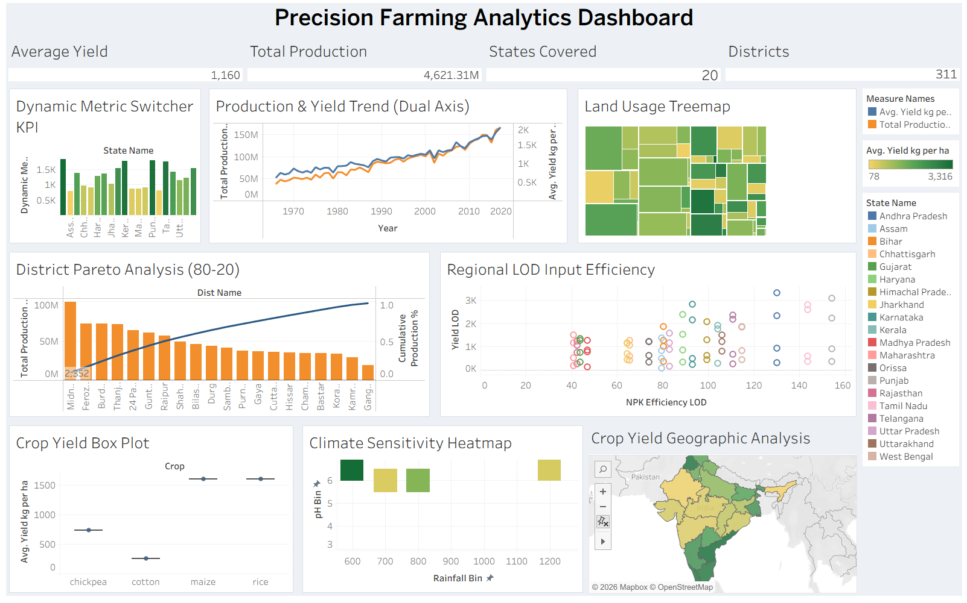

Slide 11
KEY TAKEAWAYS
From Eight Views to Three Actions
🏆
Concentrate on the top-Pareto districts
The Pareto view shows a small district cluster drives most production — prioritize field visits and extension resources there first.
⚖️
Close the input-efficiency gap
The LOD scatter and NPK balance views together flag which states/crops are over-applying nutrients without a yield return — fund the highest-gap cases first.
🌱
Treat land allocation as a lever, not a given
The treemap and box-plot views together show land isn't always allocated to the highest, most reliable yielders — revisit crop mix in low-yield, high-area blocks.
Numbers in this deck are illustrative sample data. Swap in a data export or screenshots from the live dashboard for a client-ready version.

